Slide 1

Watermelon Inc.
Treasure Hunt
E. Cogotti | F. Pesciatini | G. Petrelli | M. Gómez

Slide 2
SmartITS
Smartphone-based identification and tracking using seamless indoor-outdoor localization

Slide 3

Our Idea
Treasure hunt, uses maps and location to trigger media content and challenges on location.
Localization in both indoor and outdoor environments is a known and long-studied problem, and this paper propose a location tracking system providing a Google maps-based visualization of their trajectories with more accurate precise than a simple GPS-based location tracking system.

Slide 4
Location Based Services
01. GPS
02. Wi-fi Based Location
Only works outdoor
Highly battery-consuming
Accuracy depends on the quality of the smartphone
Outdoor position is not accurate in compared to GPS
NBL has an error of more than 300 m
03. Location fingerprint
04. RFID
Require additional hardware
No robust with changes on the environment
Expensive
Infeasible into a mass of people

Slide 5
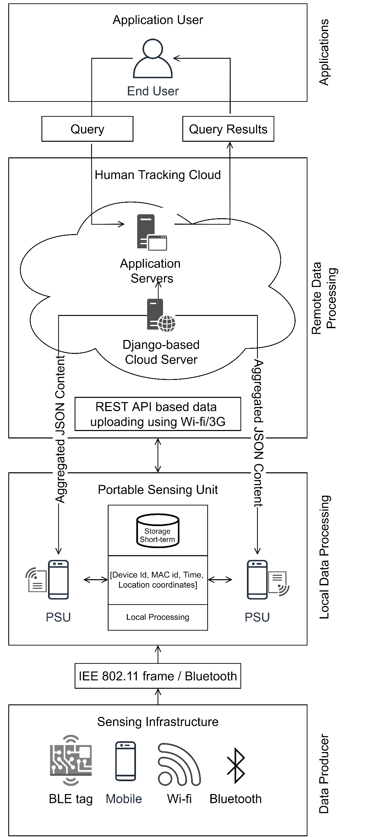
Structure
The network is made of
Client: who is tracked and can query tracking info
PSU (Portable Sensing Unit): a smartphone with a external wiki sensor which collect MAC addresses in its area
Server: a main server that collect tracking info from the PSU network and use them to get the positions
Return the position to the client if asked

Slide 6
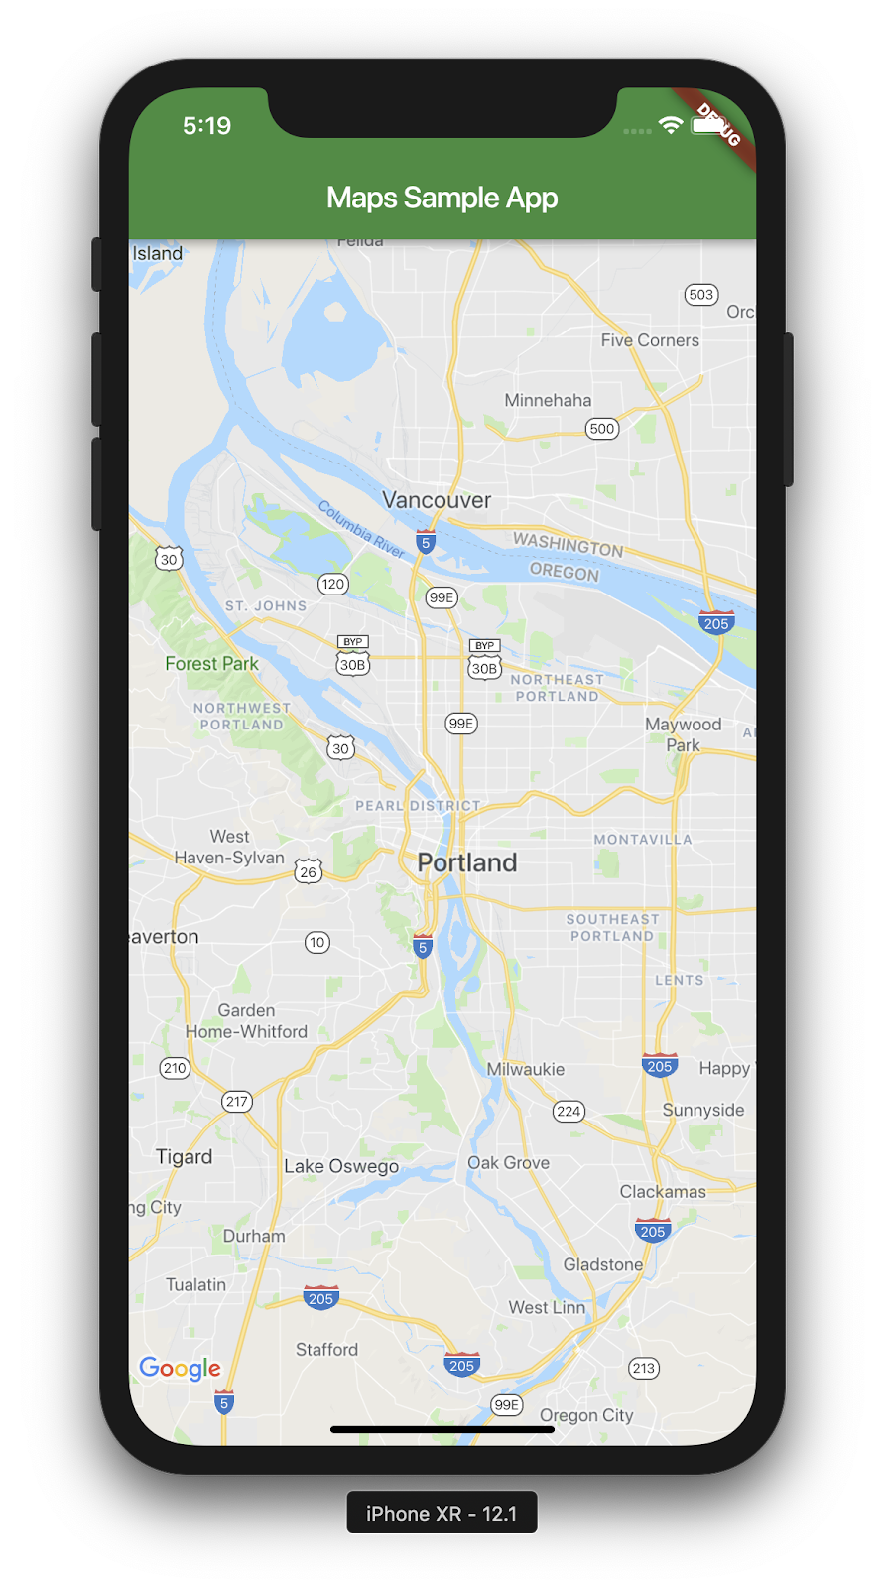
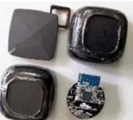
Client
The client is tracked by a smartphone or a BLT tag, which will emit periodically packets for searching access points. This packets will hold a MAC sender address which will identify each devices.
The smartphone users can register to the SmartITS service with a app, in this way if they want to get the geo-locations info they can use it to make a quarry to the Server
A client can ask for his position or of others positions (like family members) in emergency situations

Slide 7
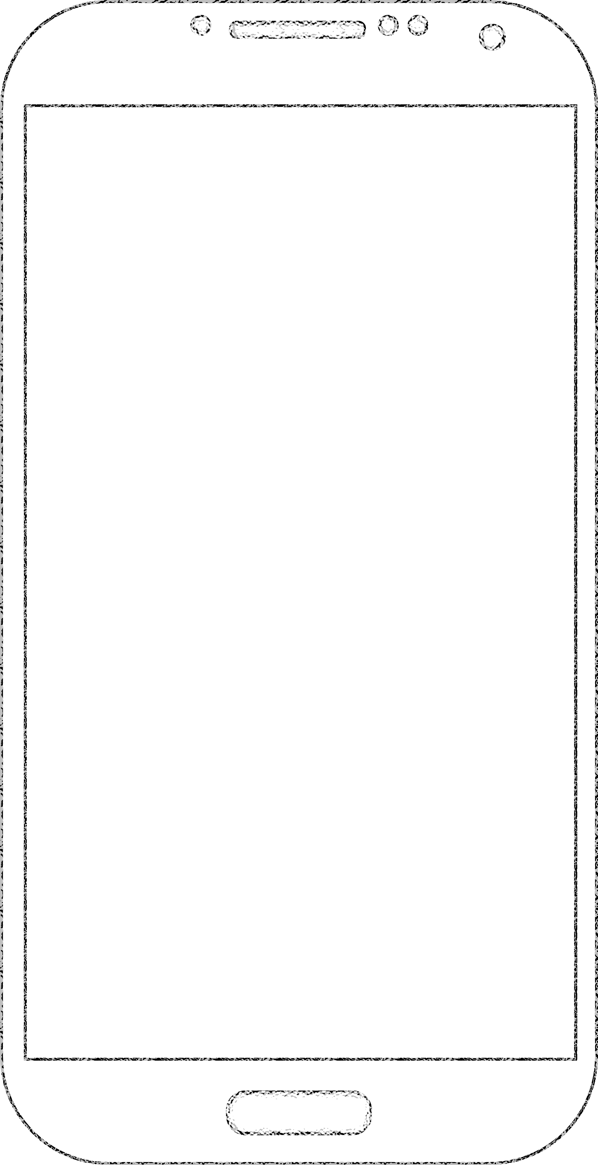
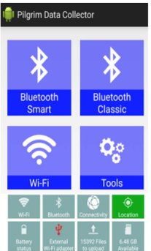
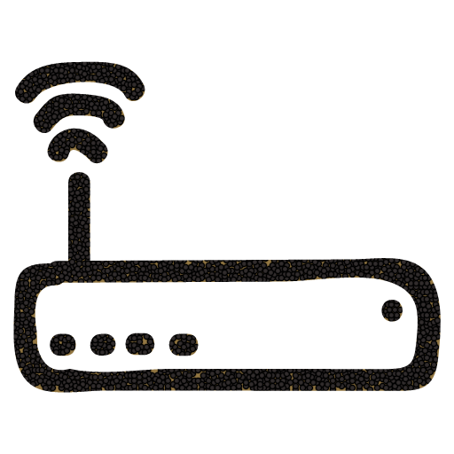
Portable Sensing Unit
It’s a static/dynamic smartphone which has to:
Collect frames sended from near wireless devices
Extract sender MAC addresses from frames
Upload the “MAC packets” to the main server
MAC packets are made by pairing MAC address with other info, like the timestamp and the GPS coordinates of when the frame was received and the PSU ID.
ALFA
Notes:
An external Wi-Fi receiver has to be use to solve the issue of the variety of drivers that each device Wi-Fi receiver uses and for the fact that the OSs usually hide from the users many info of the frames collected.

Slide 8

Cloud Server
The cloud server has 3 main jobs:
Collect the list of MAC packets from all PSUs
Derive the position of each MAC address
Sending to the clients the geo-localization information when asked.
It can also check periodically the status of PSU network and coordinate it by asking to upload:
All detected MAC addresses
Only MAC addresses from BLE tags
Only MAC addresses from users registered
Notes:
-- Derive the position of each MAC address by grouping MAC packets by their timestamp and MAC address and use triangulation algorithms on each group

Slide 9
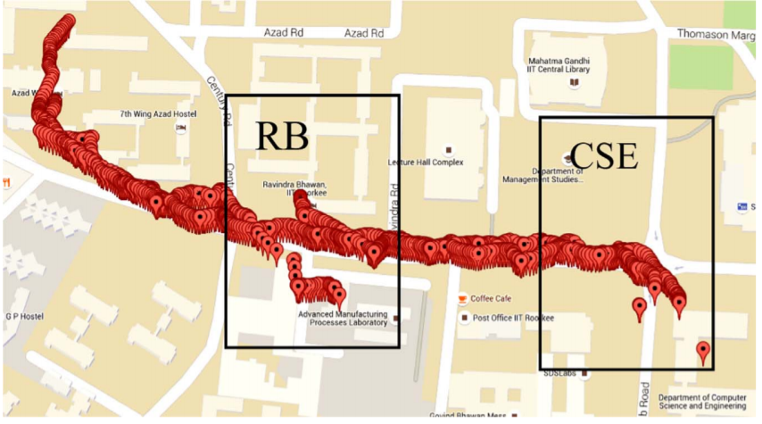
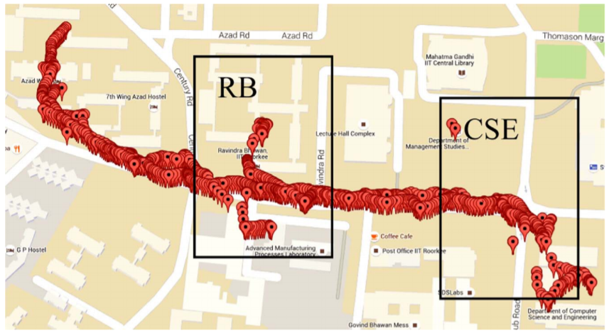
The developed system doesn’t require any Internet access on the Smartphones of the persons being tracked; neither does it require any application installation on the Client's Smartphone. Many techniques have many issues. In this paper, the propose is using Wi-Fi through their Smartphones and BLE tags.
Results
This situation arises when GPS signals strength is weak.
SmartITS can capture location coordinates inside both buildings.

Slide 10

Questions?

